Slide 1
ON ROAD VEHICLE BREAKDOWN HELP ASSISTANCE
BY
R.NAMRATHA - 22N31A12F2

Slide 2
AGENDA
Introduction
System Requirements
Application Description
Source Code
Result
Conclusion
References

Slide 3

INTRODUCTION
Vehicle breakdowns can be really frustrating and happen when we least expect them. Our project, "On-Road Vehicle Breakdown Help Assistance," looks at how to handle these situations better. We’ll explore common problems like flat tires and dead batteries, and see how current help services work. Our goal is to find new and improved ways to make roadside assistance faster and more effective.
Through our research and analysis, we hope to provide practical insights and strategies that can help drivers manage breakdowns with greater ease and confidence.

Slide 4

EXISTING SYSTEM
Currently, roadside assistance services offer essential help for drivers facing breakdowns like flat tire changes, fuel delivery for out-of-gas situations and many more .The existing system is facing challenges such as variable response times, limited service coverage in remote areas, and delays due to the need for dispatch and resource availability.
PROPOSED SYSTEM
Our proposed system aims to enhance roadside assistance by integrating advanced technology and improving service efficiency. We suggest developing a website that allows drivers to request help quickly, track the arrival of assistance in real time, and provide detailed vehicle diagnostics with faster response times, remote diagnostics, and on-the-spot minor repairs

Slide 5
SYSTEM REQUIREMENTS
SOFTWARE REQUIREMENTS :-
Scripting Languages : HTML, CSS, and JavaScript
IDE : Visual Studio
Database : MongoDB
Operating System : Windows
HARDWARE REQUIREMENTS:-
Processor: Intel i5
RAM: 8 GB minimum
Storage: SSD with at least 256 GB

Slide 6
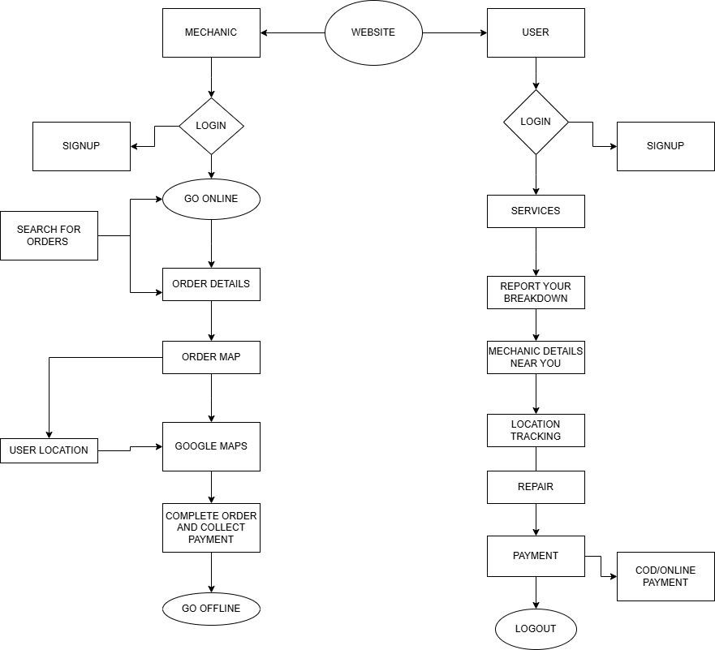
APPLICATION DESCRIPTION
SYSTEM ARCHITECTURE:-

Slide 7
MODULES
USER (DRIVER) MODULE
The User Module manages all user-related activities, ensuring a secure and personalized experience. It handles user profiles, including personal details, contact information, and service history. Through this module, users can securely log in with OTP verification, request assistance, and choose the type of service they need. The module provides real-time tracking and notifications to keep users updated on mechanic status and arrival. It also maintains a record of past services and allows users to leave ratings and reviews, enhancing the overall reliability and user experience of the system.
MECHANIC MODULE
The Mechanic Module manages all information related to mechanics, including their profiles, real-time location, availability status, and service types (e.g., tire repair, fuel delivery). It allows the app to search for nearby mechanics, display their details, and track their location. The module also records user ratings and reviews for quality assurance, helping users choose reliable mechanics based on past performance.

Slide 8
SOURCE CODE
SERVER.JS FILE
const express = require('express');
const connectDB = require('./config/db'); const path = require('path');
const fs = require('fs'); const app = express();
// Connect to MongoDB connectDB();
// Middleware to parse JSON bodies app.use(express.json());
// Log public directory contents for debugging
console.log('Public Directory Contents:', fs.readdirSync(path.join( dirname, 'public')));
// Routes
app.use('/auth', require('./routes/auth')); app.use('/mechanic', require('./routes/mechanic'));
// Serve static files from the 'public' directory app.use(express.static(path.join( dirname, 'public')));
// Force redirect to login.html when accessing '/' app.get('/', (req, res) => {
const filePath = path.join( dirname, 'public', 'login.html');

Slide 9
// Check if the file exists
if (fs.existsSync(filePath)) { res.sendFile(filePath);
} else {
res.status(404).send('login.html not found');
}
});
// Port setup
const PORT = process.env.PORT || 5000; app.listen(PORT, () => {
console.log(`Server running on port ${PORT}`);
});

Slide 10
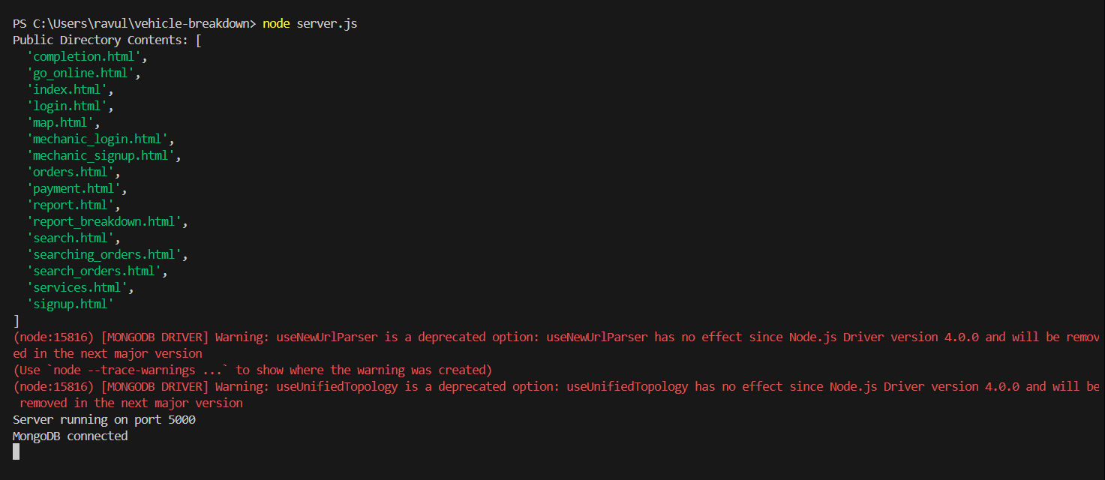
RESULT

Slide 11
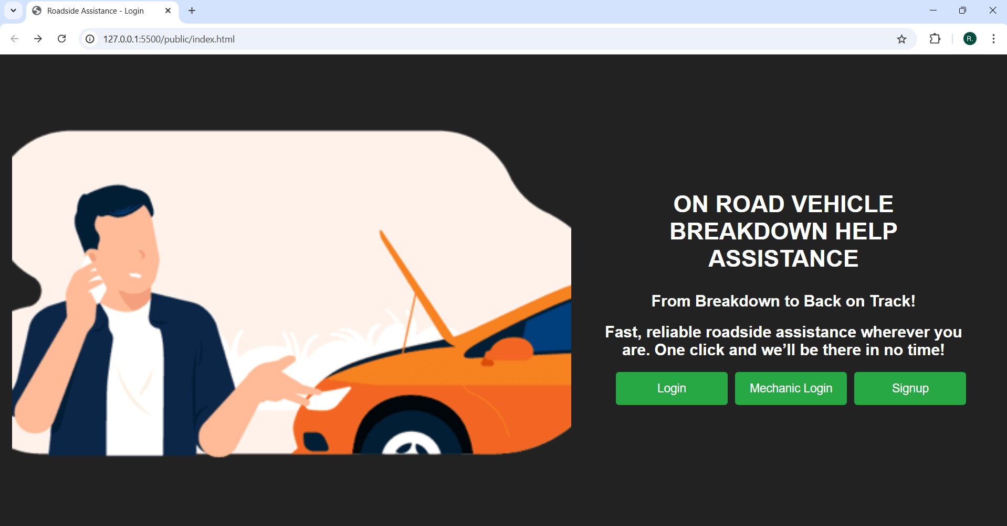

Slide 12
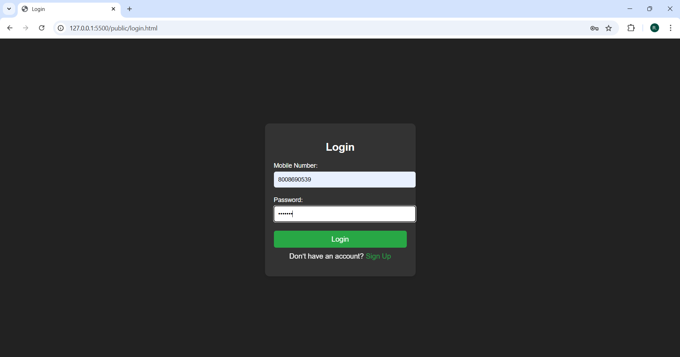

Slide 13
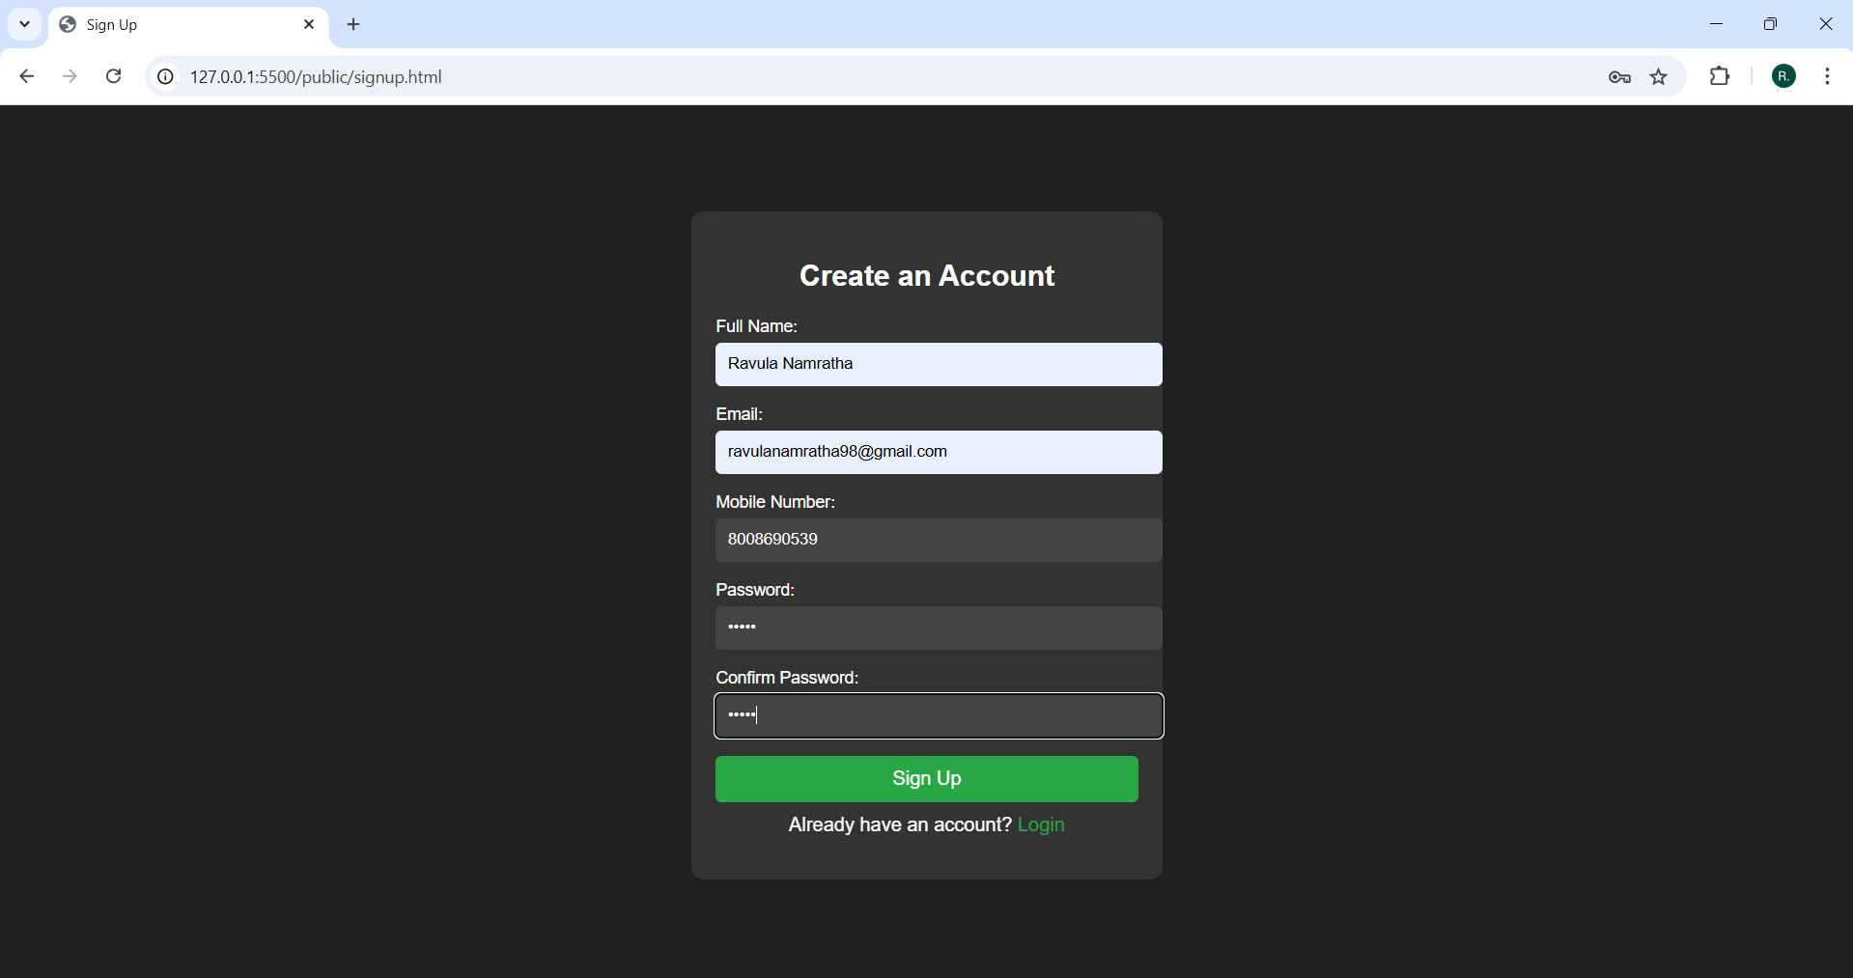

Slide 14
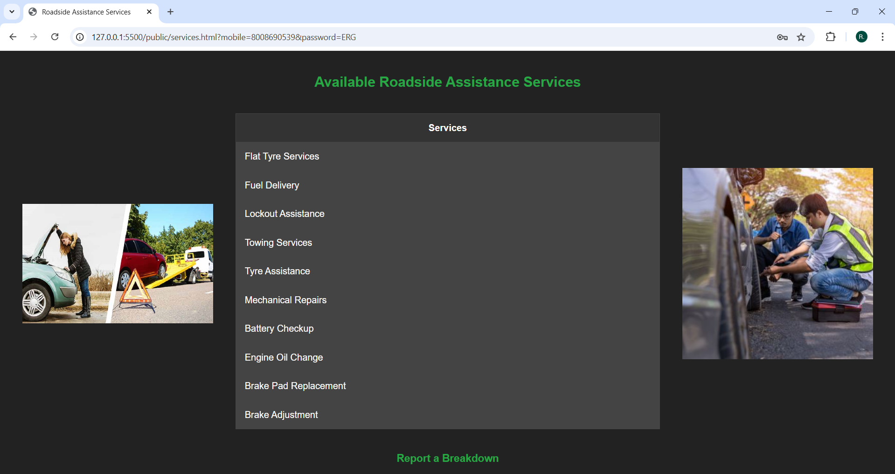

Slide 15
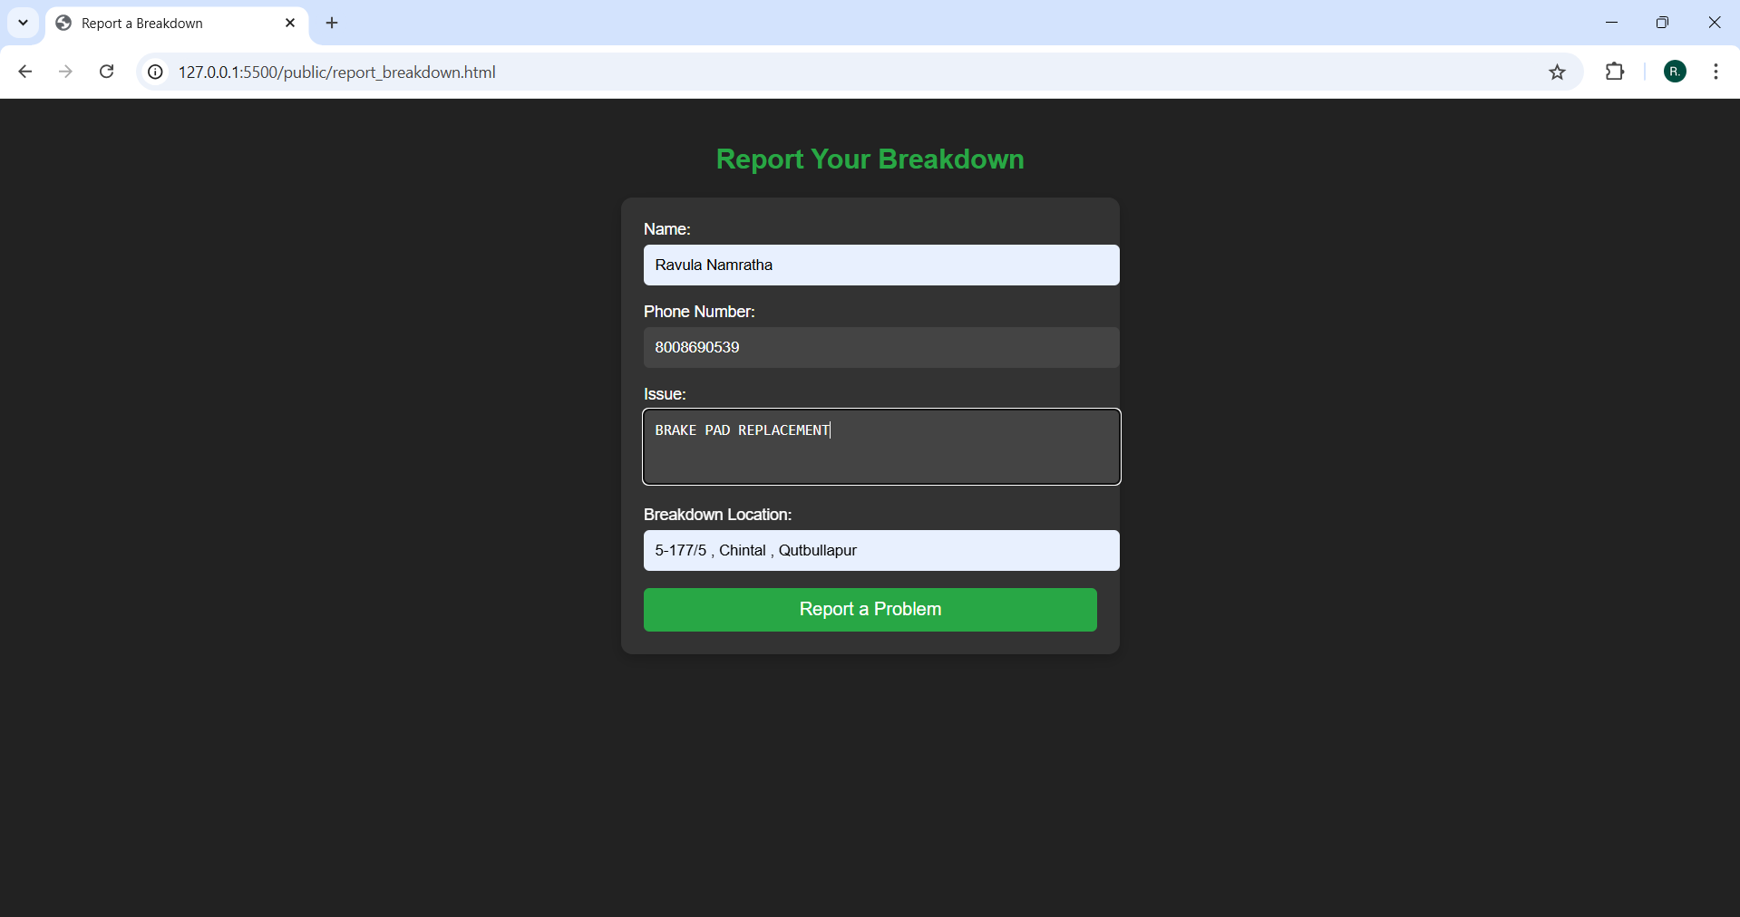

Slide 16
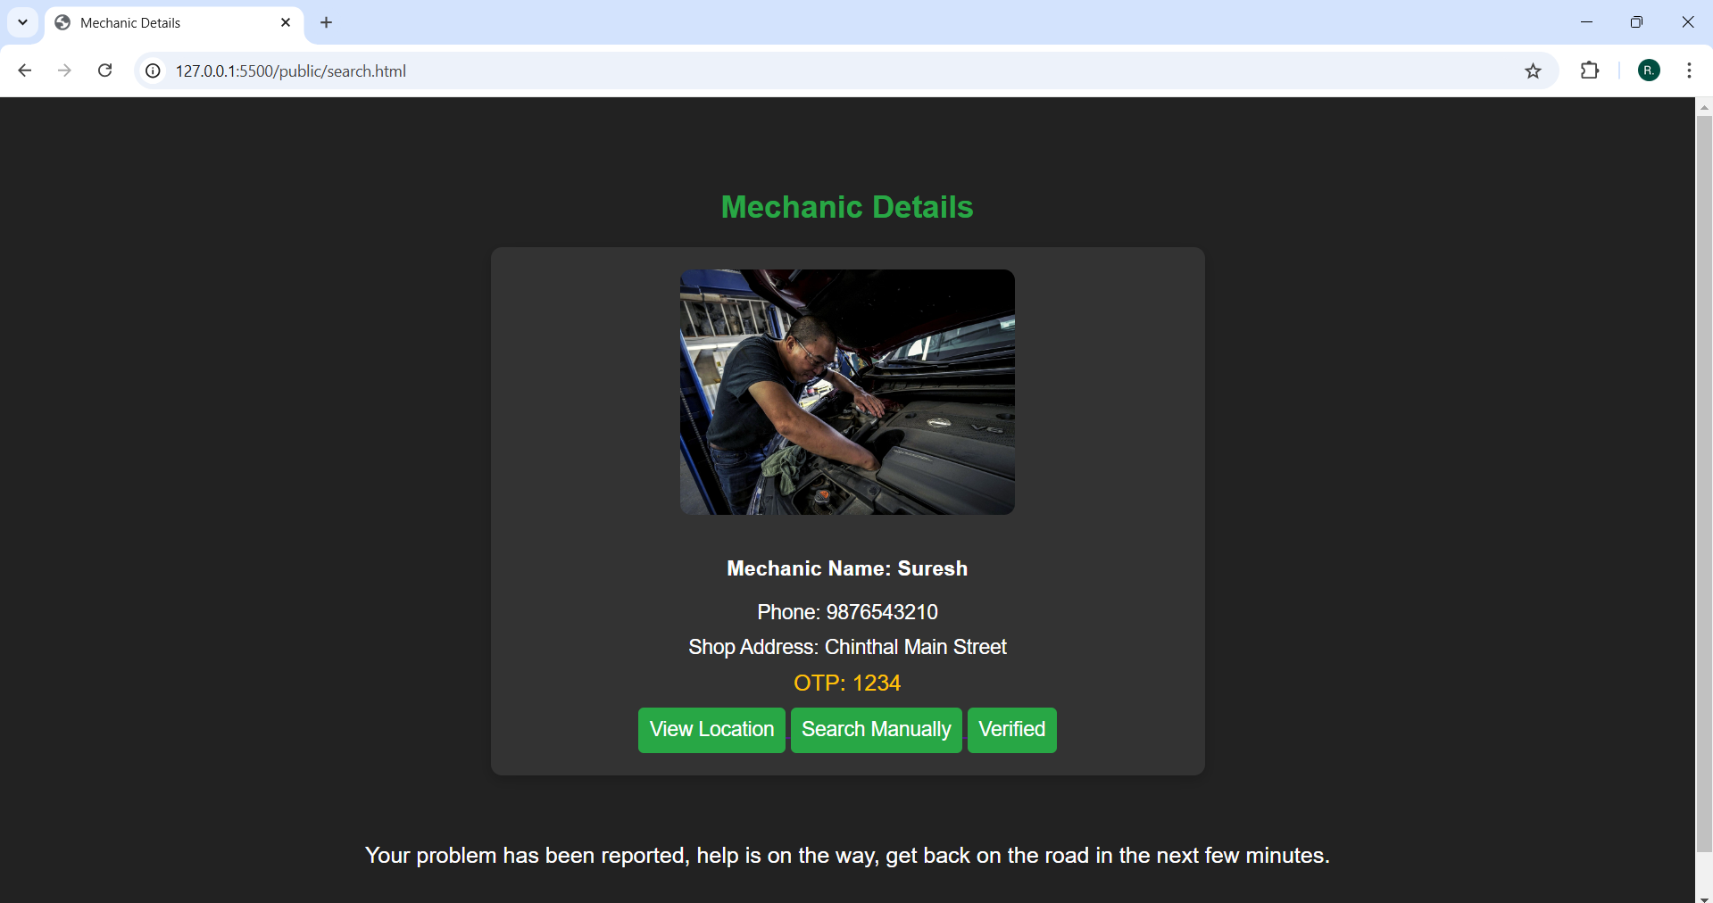

Slide 17
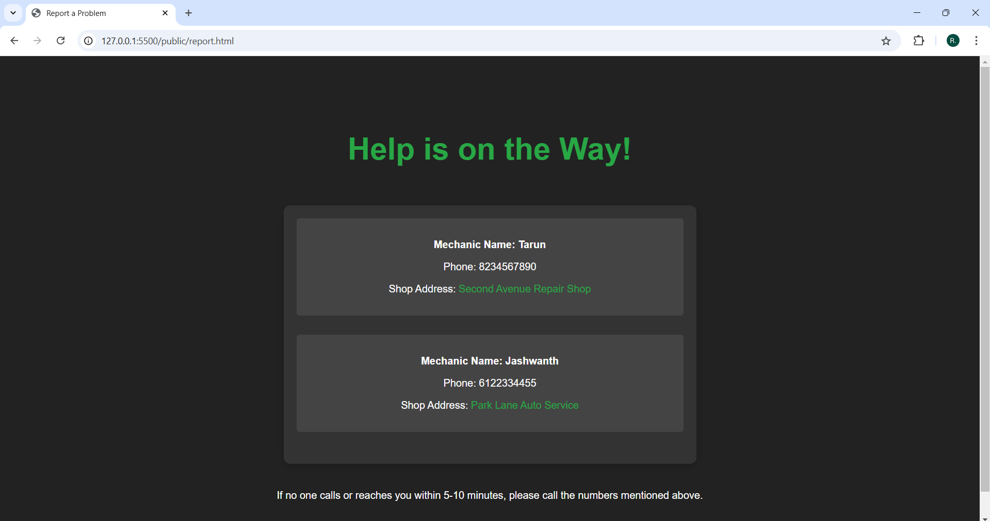

Slide 18
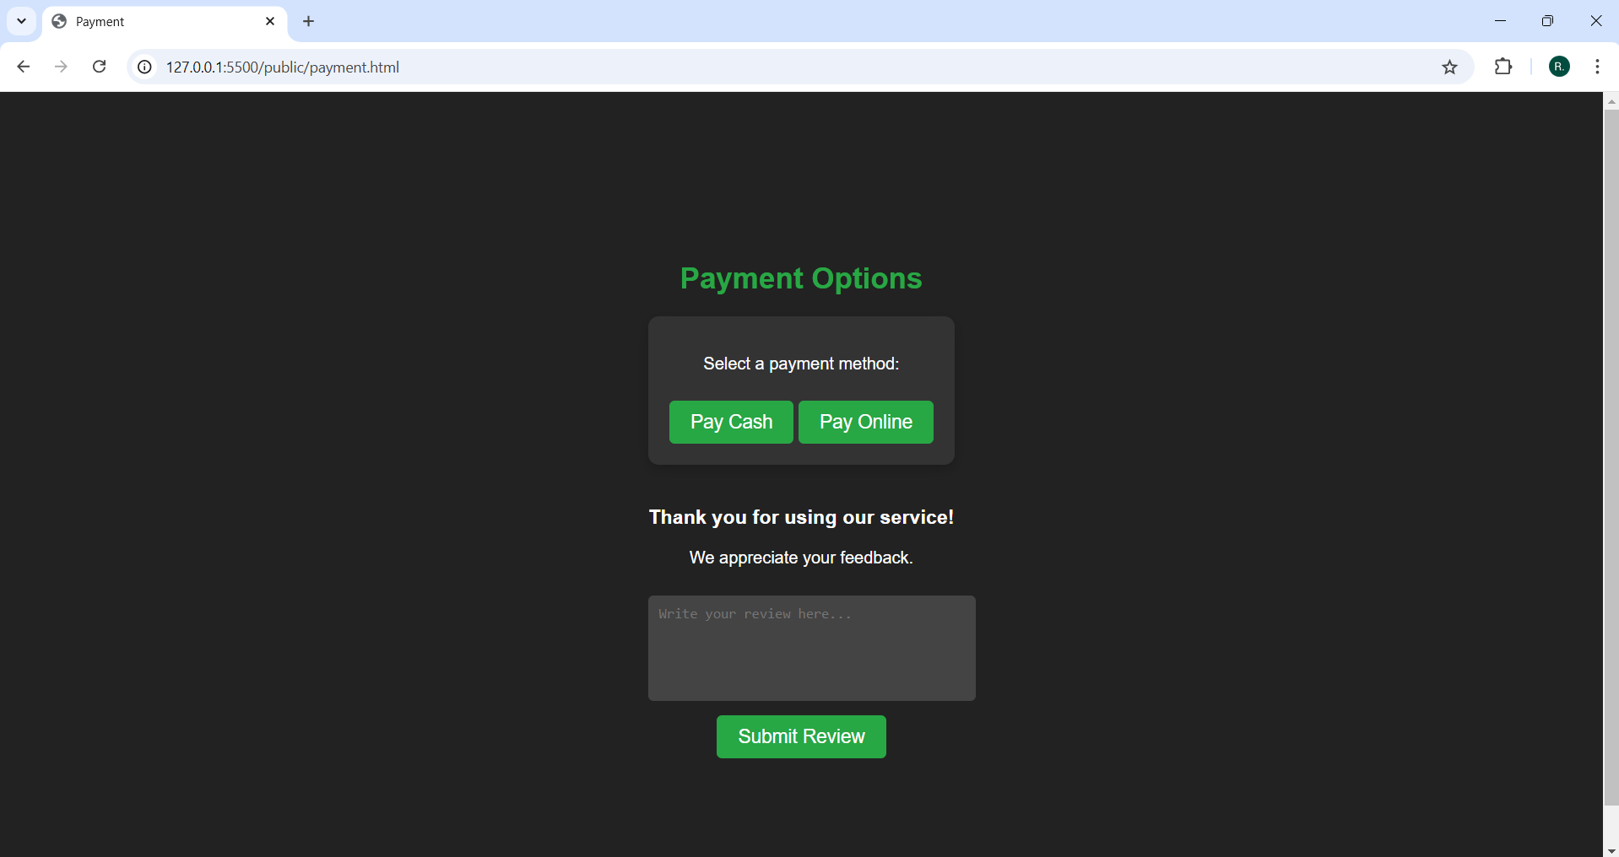

Slide 19
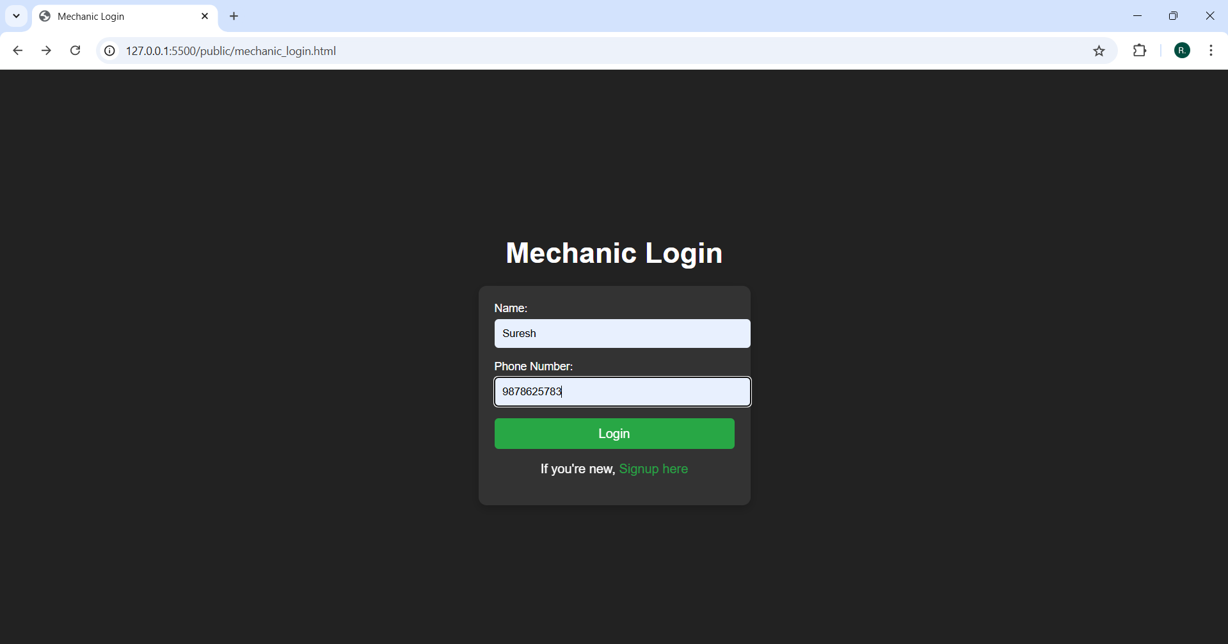

Slide 20
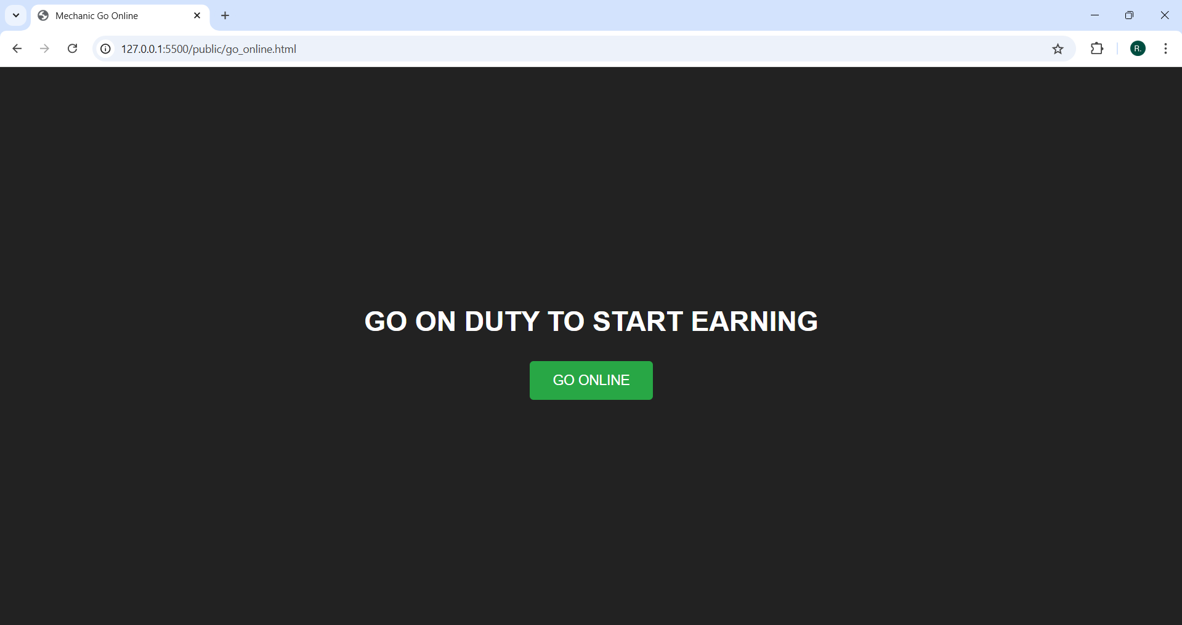

Slide 21
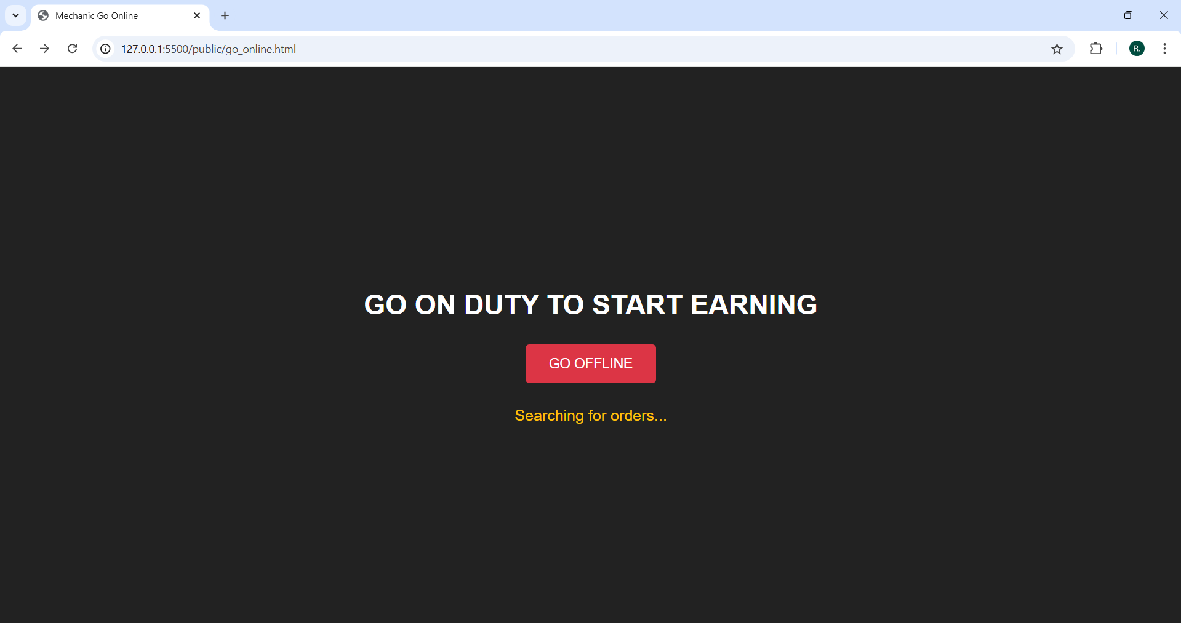

Slide 22
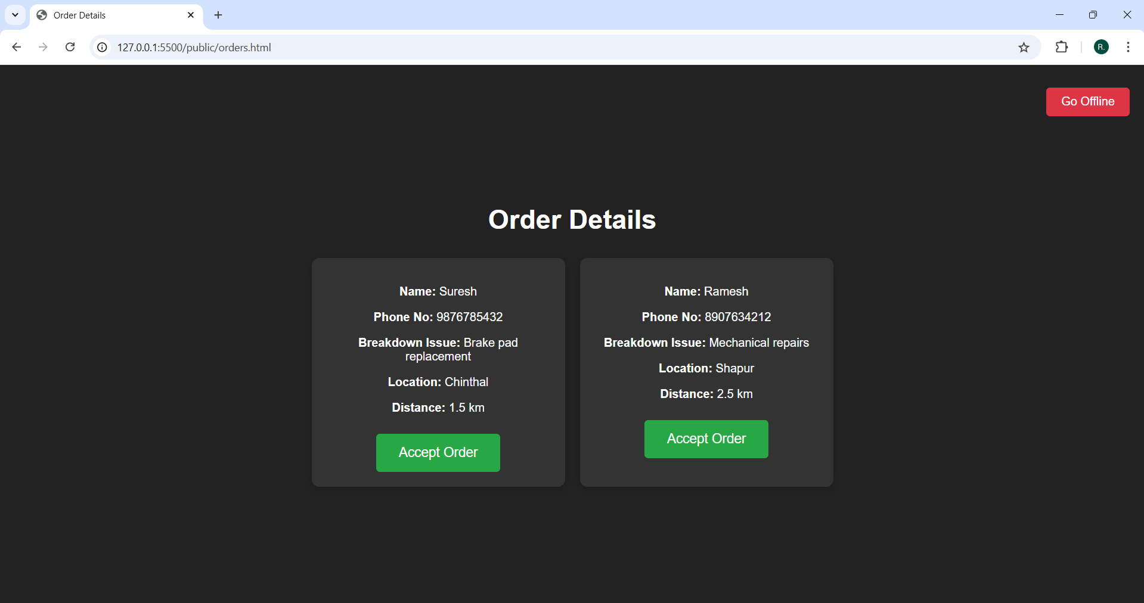

Slide 23
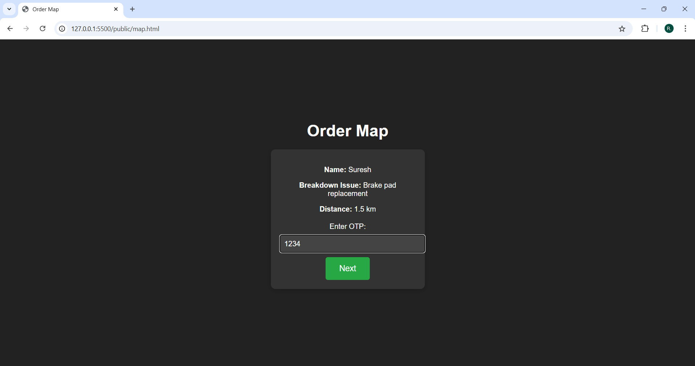

Slide 24
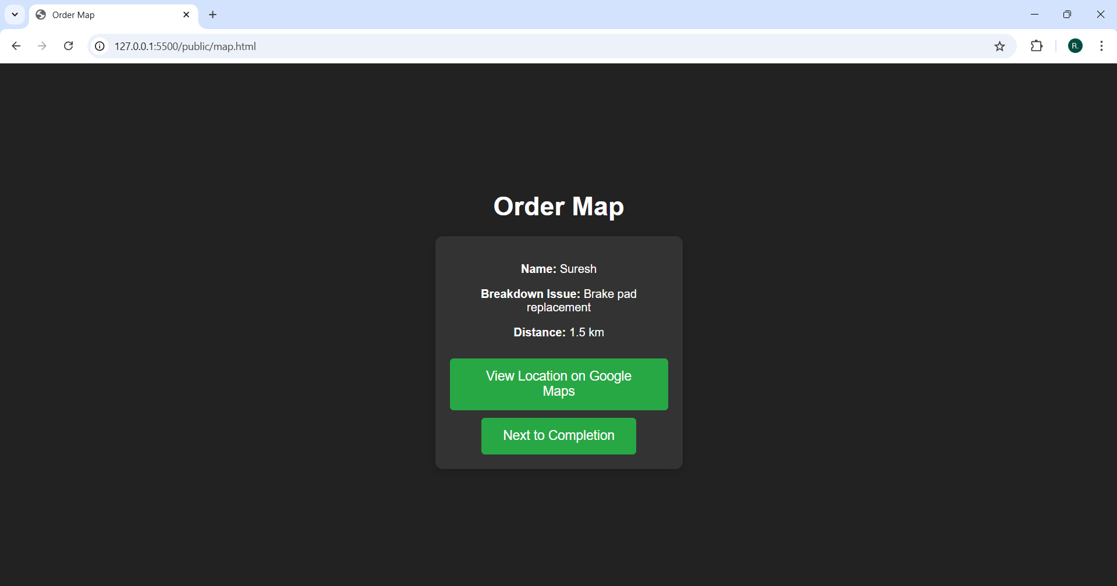

Slide 25
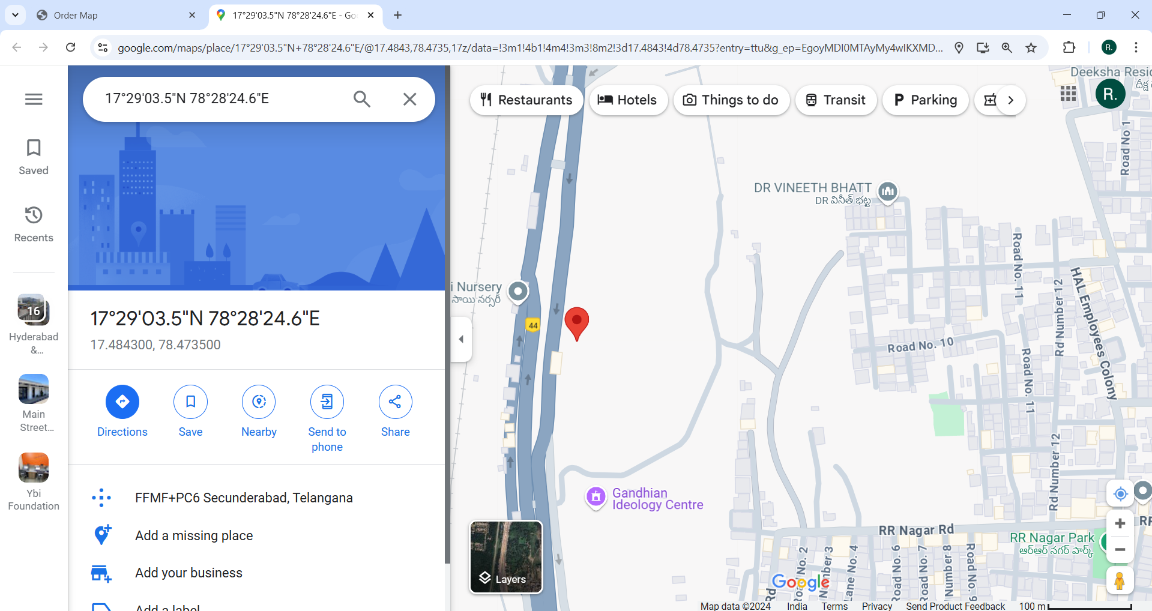

Slide 26
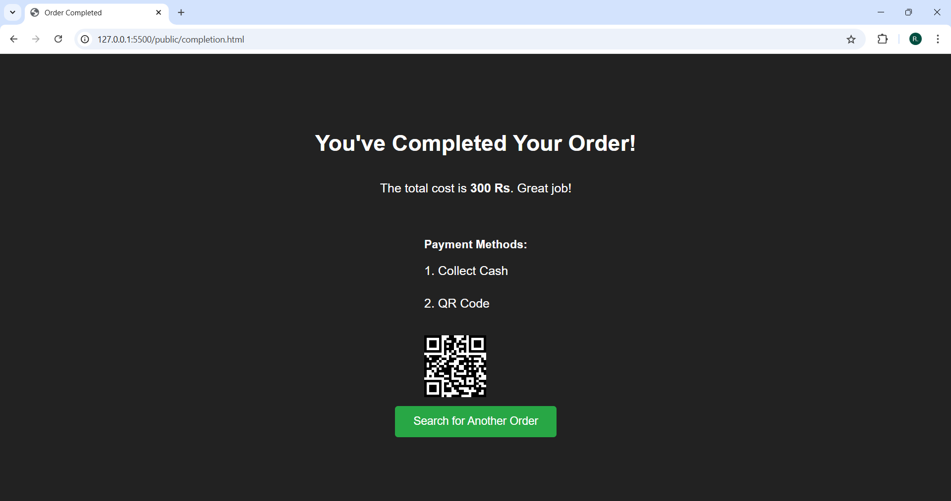

Slide 27
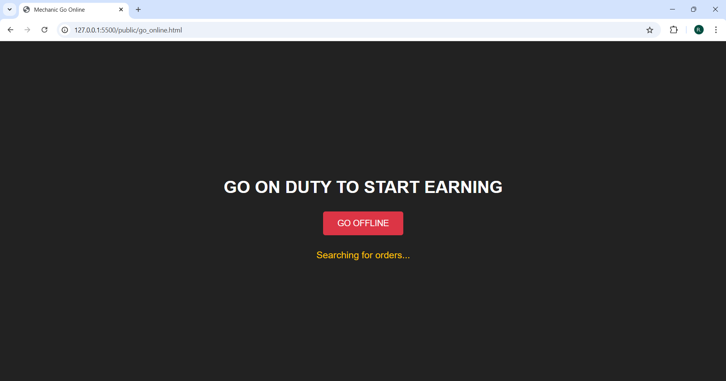

Slide 28

CONCLUSION
The on-road vehicle breakdown help assistance website provides a streamlined solution for vehicle owners facing unexpected breakdowns. With its user-friendly interface, the website enables users to quickly report issues, verify their identity through OTP, and access real-time assistance via a nearby mechanic. Integrated features like Google Maps navigation, service details, and cash on delivery for services ensure a reliable and convenient experience. This digital platform enhances roadside assistance accessibility, enabling users to get back on track efficiently and with peace of mind.

Slide 29
REFERENCES
J. Whipple, W. Arensman and M. S. Boler, "A public safety application of GPS-enabled smartphones and the android operating system," 2009 IEEE International Conference on Systems, Man and Cybernetics, 2009,pp. 2059-2061.
Anon., 2019. Youtube. [Online] Available at:https://www.youtube.com/watch?v=E1eqRN TZqDM&t=551s
Anon., 2020. Git Hub. [Online] Available at: https://github.com/

Slide 30
THANK YOU

